Slide 1
Serious Gaming: Engreeneering Game
NA-RHD-ZZ-XX-PP-Z-0001
Project related
15 June 2023

Slide 2
Introduction
Presentations about: Serious gaming, Nature based solutions and the Engreeneering game
Mentimeter
Play!
Make your own game case

Slide 3
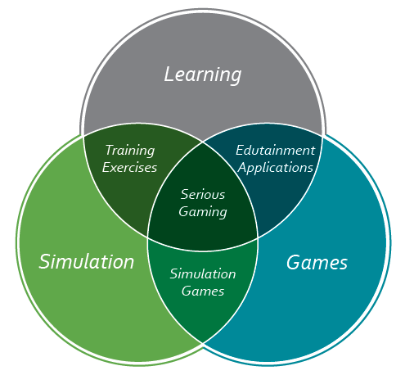
Serious gaming

Slide 4
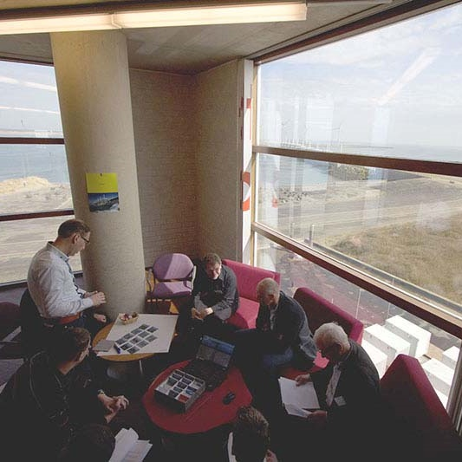
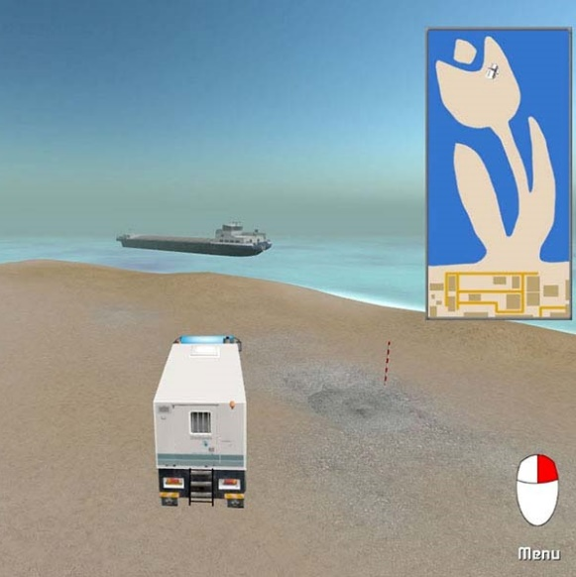
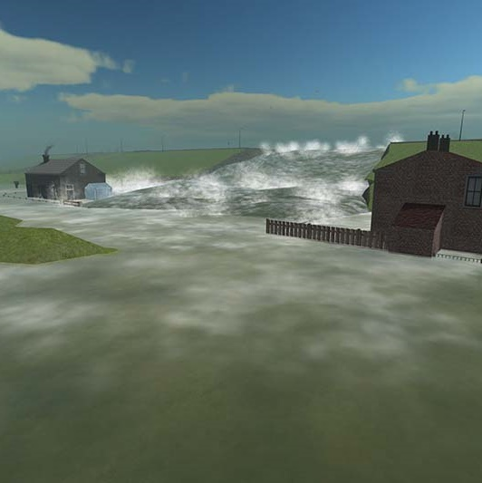
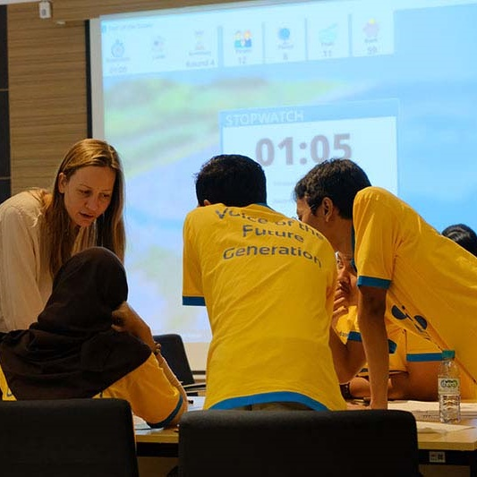
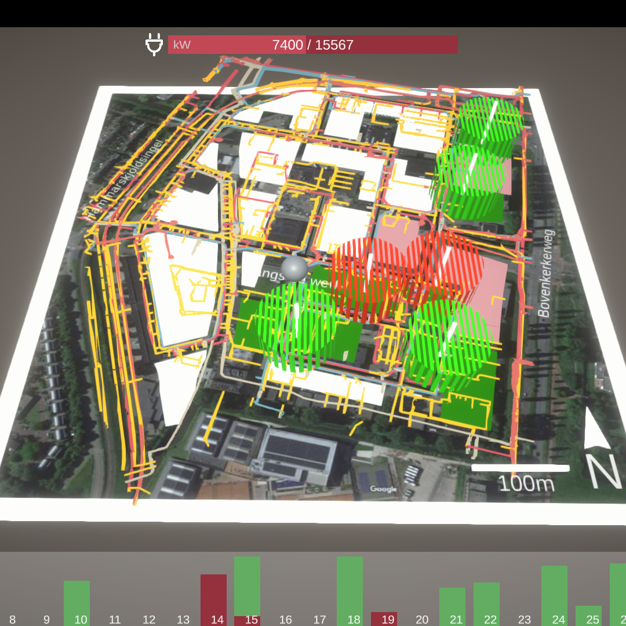
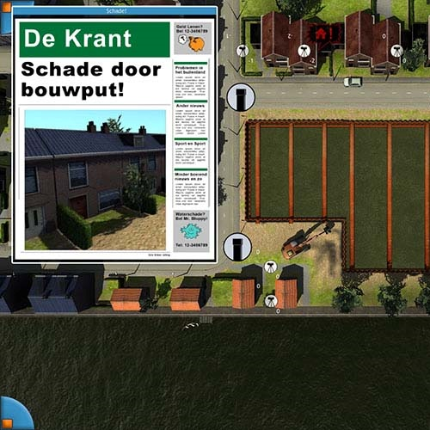
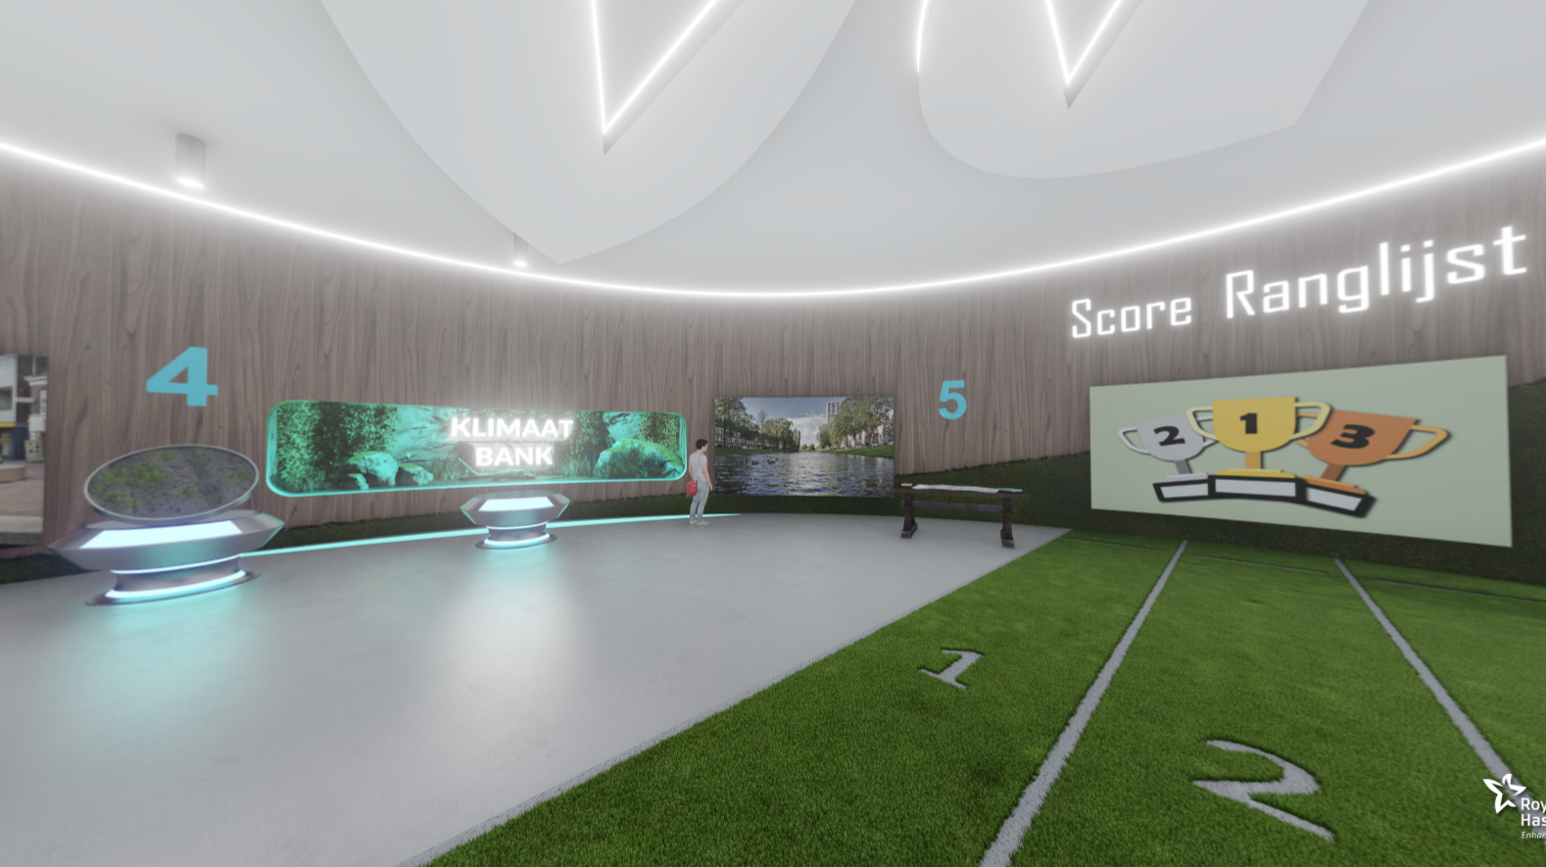
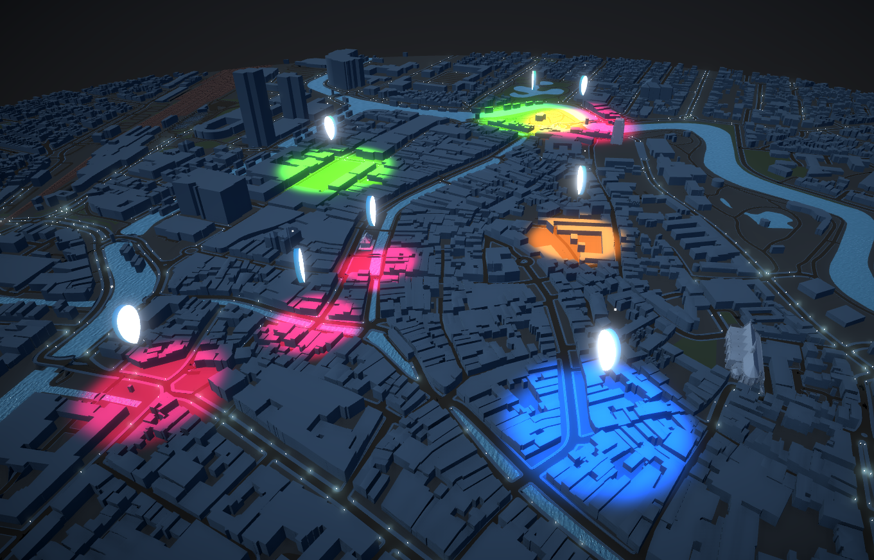
Serious gaming
“Applied learning”
Sharing knowledge through games
“Learning by doing” (training)
Failure is an option > better learning
“Simulation”
  More focused on reality
“Gamification”
  … is something else
  Competitive / fun priority
Notes:
Simulation: simcity, flight simulators, etc. These try to recreate reality.
Gamificiation: try to improve your score/time/etc to a competitor. Or collect something something on the way to supermarket, etc
Based on rewards

Slide 5
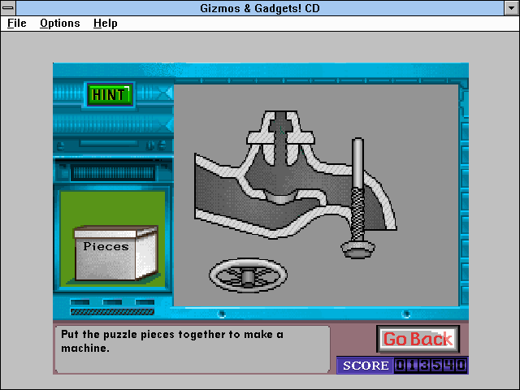
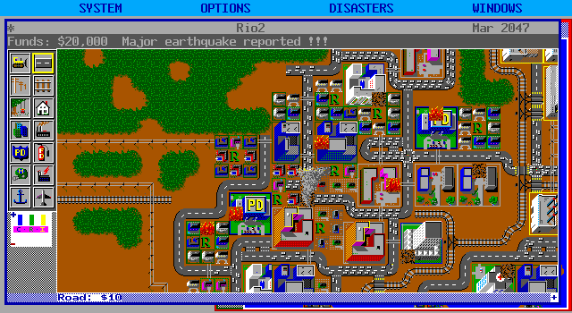
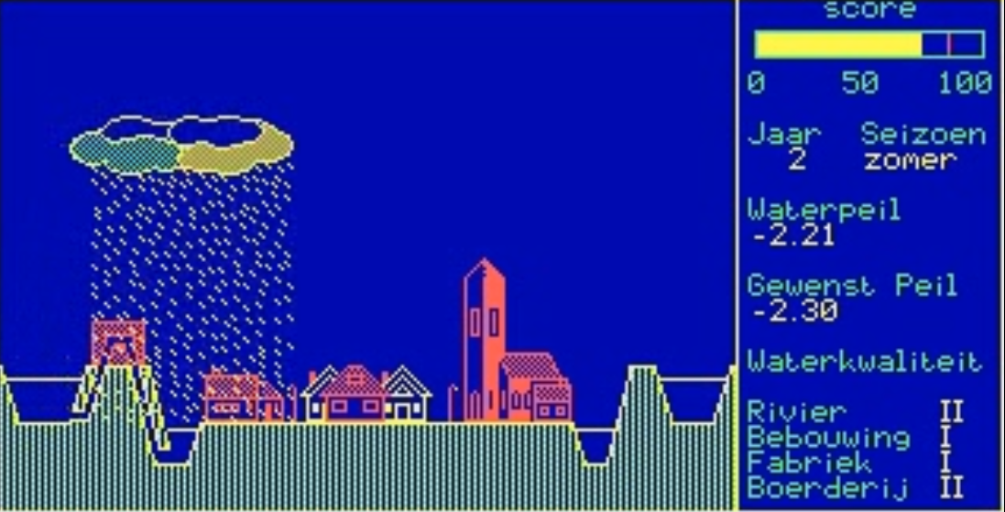
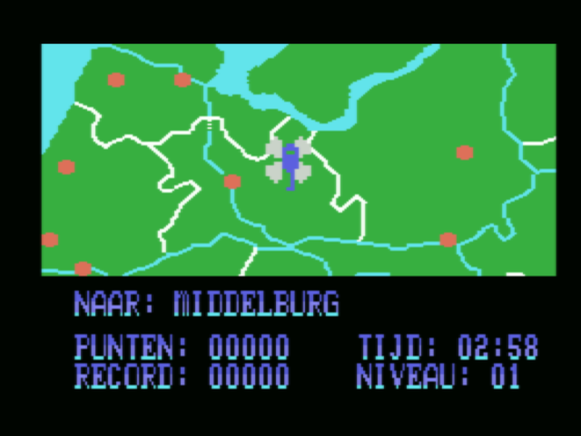
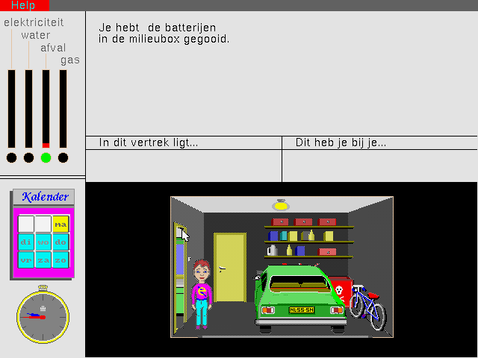
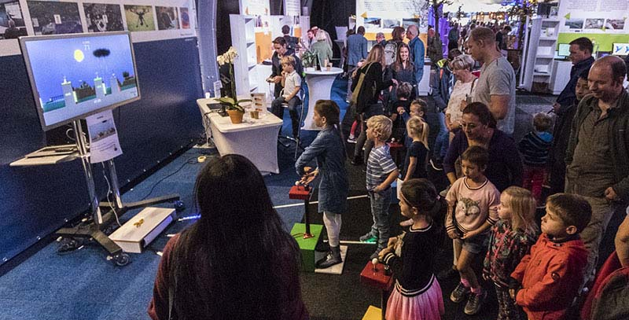
Serious games have been around for a while
Gizmos & Gadgets! - 1993
Sim City (classic) - 1989
Zorg om het water - 1989
Topografie - 1984
Thuis in het milieu - 1990
“Pompeii” - 2018

Slide 6
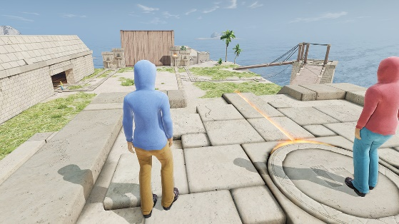
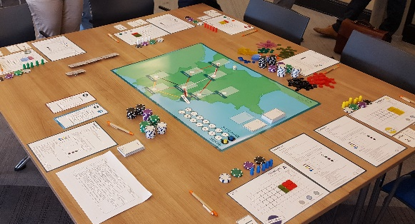
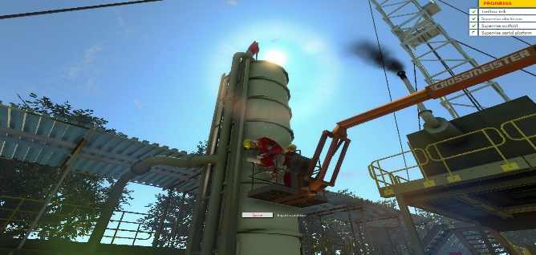
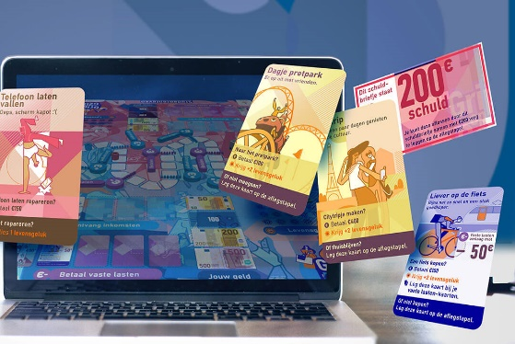
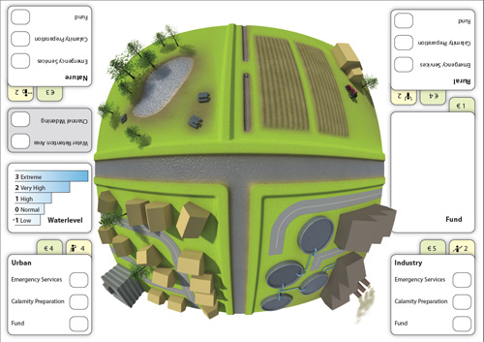
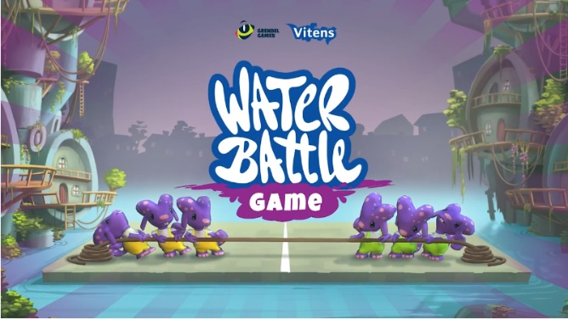
Serious games have been around for a while
TeamUP - 2013
Rail Cargo game - 2016
Hazard Recognition Game - 2008
Grip op je Geld - 2021
FloRiMa - 2008
“Water Battle” - 2018

Slide 7
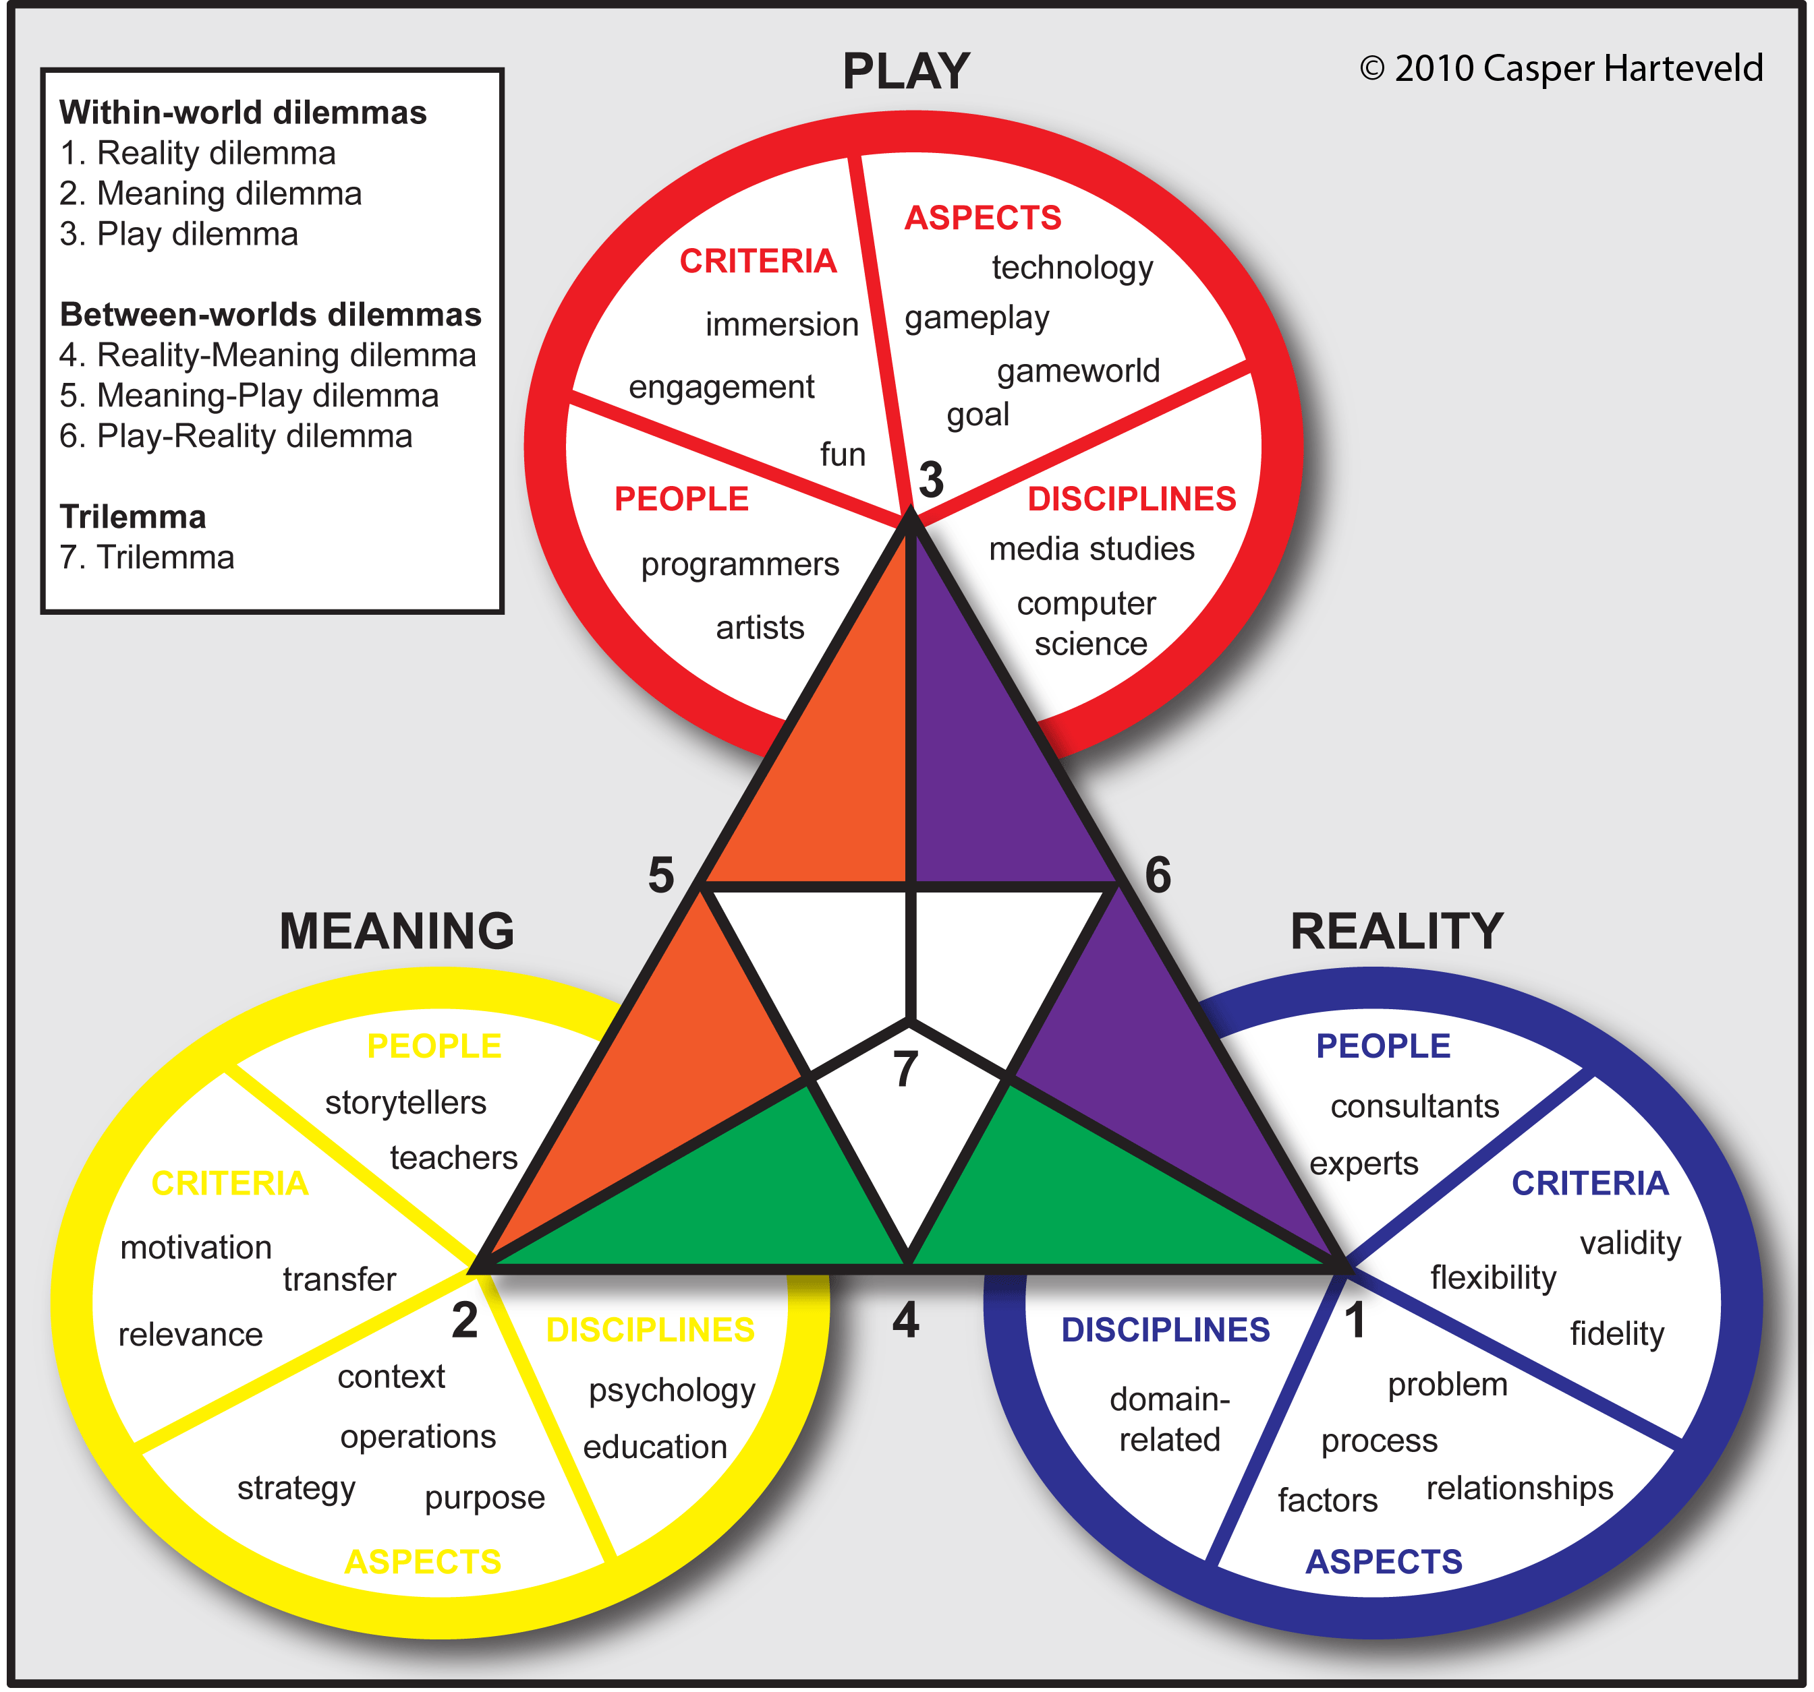
Designing serious games (some considerations)
Have insight in process(es) and the subject
Finding a common ground between teams?
What do you want your players to take home after a session?
Do you want players to play more often or is it a one-off?
Balancing ‘play’, ‘meaning’ and ‘reality’
Etc…

Slide 8
Nature based solutions

Slide 9
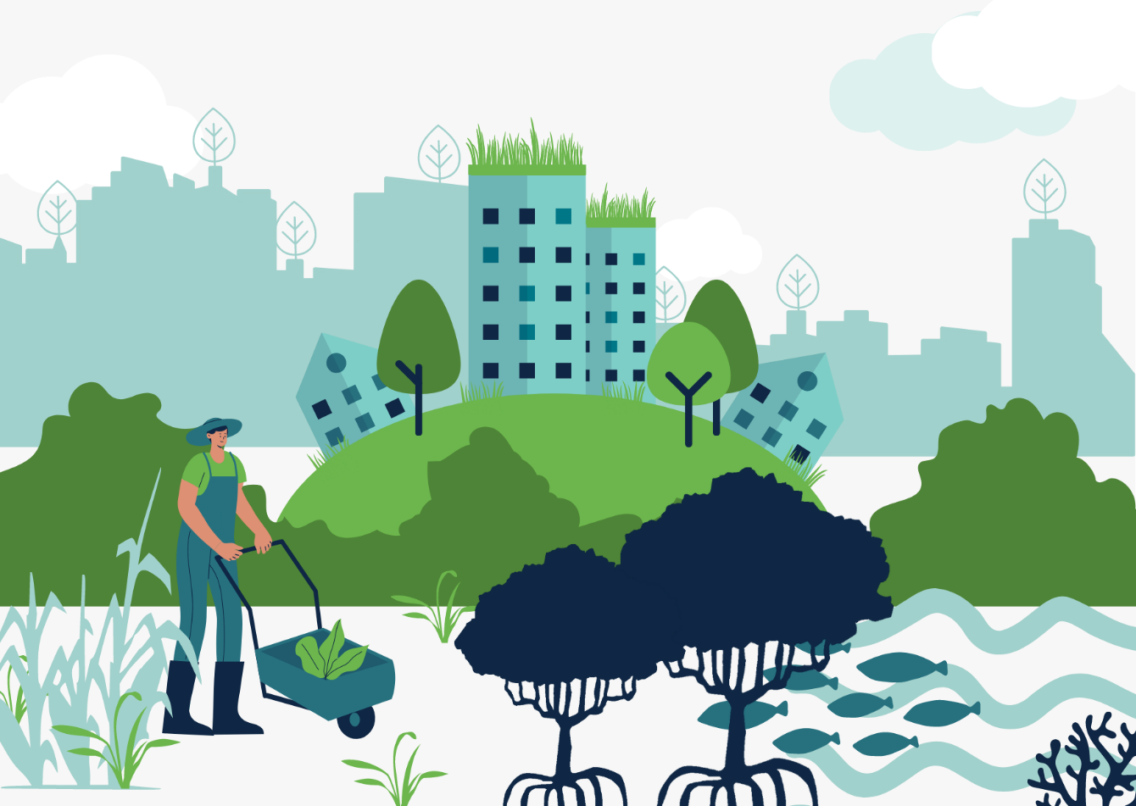
Defining Nature based Solutions
Nature as a starting point
“actions to protect, sustainably manage, and restore natural and modified ecosystems that address societal challenges effectively and adaptively, simultaneously providing human well-being and biodiversity benefits” (IUCN)

Slide 10
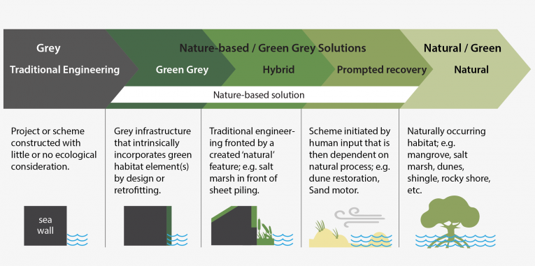
What are Nature-based Solutions?
From green to grey:

Slide 11
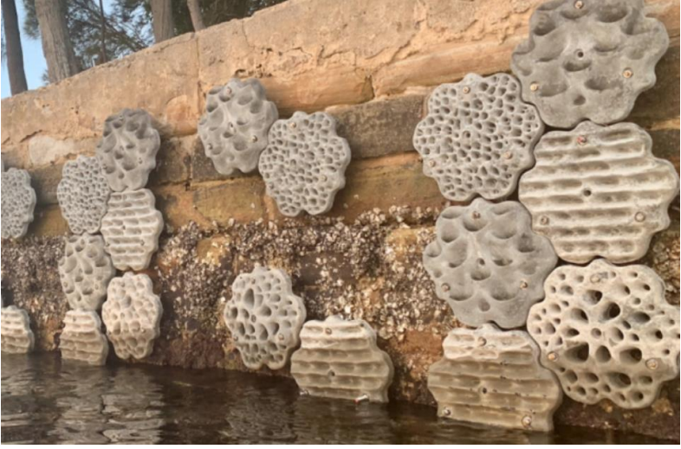
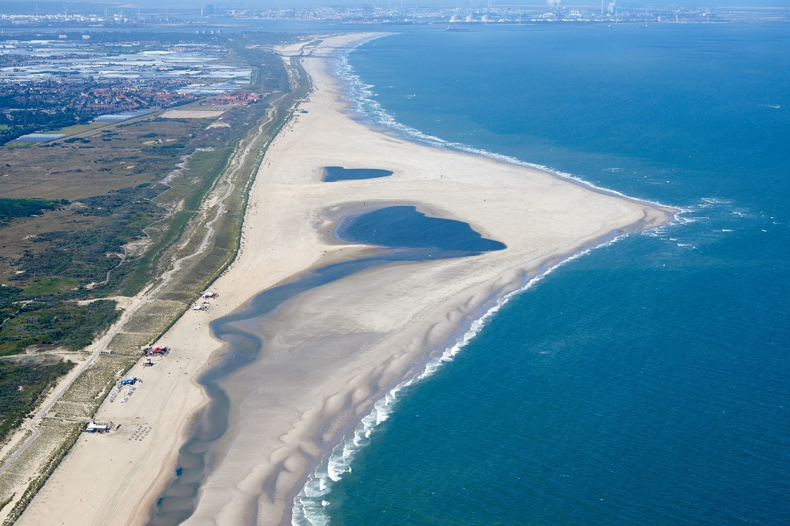
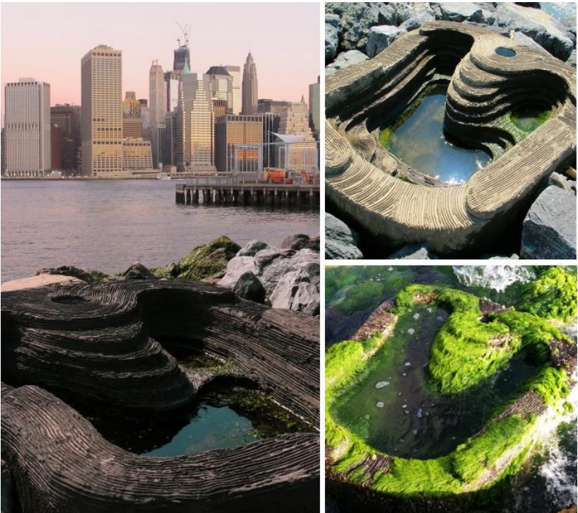
Examples Nature-based Solutions
Small scale and landscape scale
Notes:
Small scale:
Harbours:
Small add on habitats
Tidal pool
The tidal pools create local ecosystems that mimic rock pools and encourage an important variety of plant and animal life to thrive in a habitat protected from the elements.
Large scale:
Sand engine
A Sand Engine is a nourishment with a volume large enough to provide the coast with sufficient sand for a long time. This large volume is placed in a location from which the sand can be distributed by coastal processes over a larger part of the coast. The construction is simple and cheap due to its size and the fact that a lot of sand is supplied in a single location. Across the world ‘feeder berms’ and ‘feeder beaches’ are already in use in several locations. The Sand Engine as constructed for the Delfland coast is unique. Long term coastal maintenance is anticipated (over 20 years), a very large volume is supplied (over 20 million m3) and nourishment is combined with the promotion of recreation and nature.

Slide 12
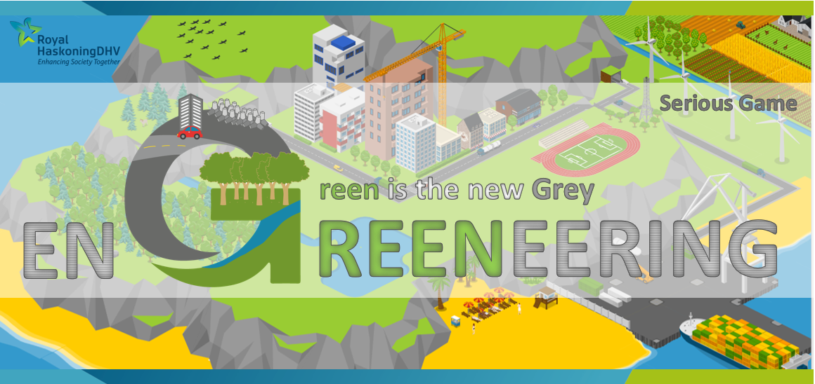
Danny Booij, Hugo Morgan, Natalie Martinkova, Peter Walker, Santiago Aguilar, Bas van Spronsen

Slide 13
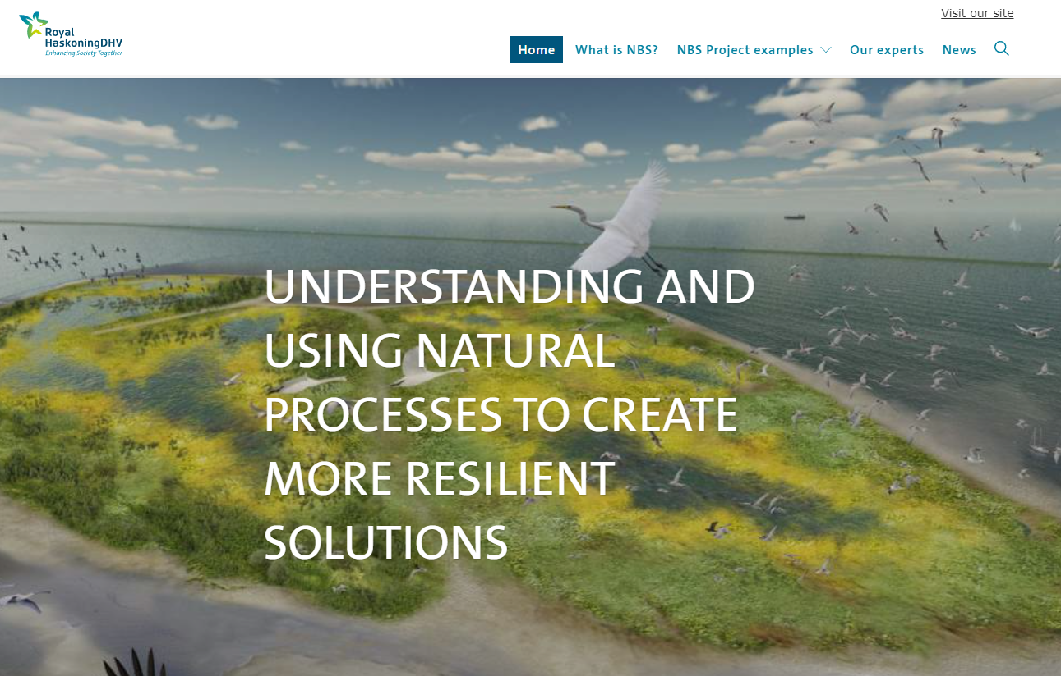
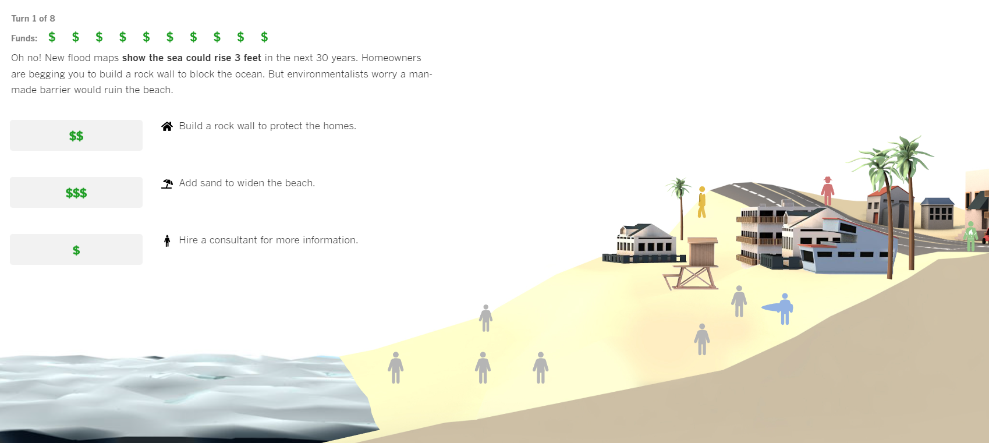
Overview
Issue: Lack of awareness for clients around Nature-based Solutions and the benefits they bring
Challenge: Communicate the benefits and need for Nature-based Solutions (NbS) to key clients and internal stakeholders
Approach: Serious game, development split into three strands
Notes:
Mixed team,
Intentionally integrate nature into a design or solution to problem
Done a number of these projects within RH now such as the Marker Wadden project you can see onscreen where natural islands were created to provide marshland and riverbank habitat
More sustainable long term, theoretically can cost less, is self sustaining and has a lower carbon footprint
Benefits for RH, pushing this more, number of ecological experts now specialising in NbS
Identified an issue that RH want to expand in this area but our clients don’t necessarily know or understand the benefits of NbS
Decided that a serious game would be a good way to communicate this, allow clients to make their own decisions and see the results for themselves
Particularly liked examples including one from LA Times around coastal flooding, where the user can make choices over time and see how their choices affect the outcomes
Given the large team, split development into storyline and production of the decision tree, coding, then visuals, in order of project
split into decision tree/coding/visuals but all input on each

Slide 14
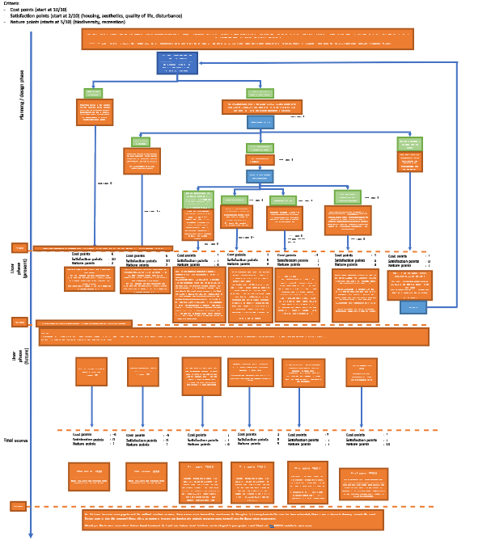
Storyline and decision Tree
We developed a decision tree based on a fictional town adjacent to a river and close to a nature reserve.
We produced three scoring criteria for the game: cost, satisfaction and nature points.
The idea is that the user makes several decisions in the planning phase, after this, construction takes place, and the user sees the short-term consequences to the decisions they made (+5 years)
The last stage of the game skips 25 years to see the long-term effects of their decisions.
The decision tree was visualised on PowerPoint.

Slide 15

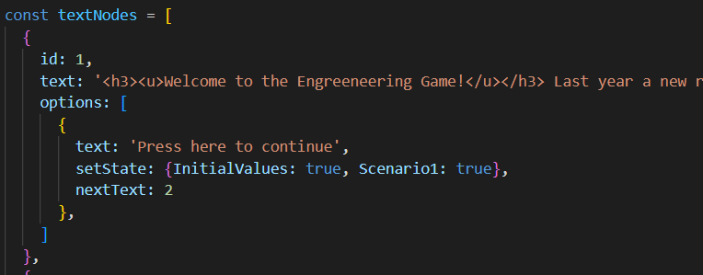
Coding
A combination of Javascript, HTML and CSS languages was used as the coding languages to create the game.
Setting up HTML page
Creating the div classes for the container, the buttons, score points and the text
Prepare stylesheet
Set the elements into the JavaScript code
Creation of functions to run the game, these can be broken down into functions to:
  Display options to select
  Display the text message
  Selection of options
  Definition of all states (as variables)
  Updating the scores from previous states
  Image changer (WIP)
  Creation of the body (making the decision tree come to life)

Slide 16
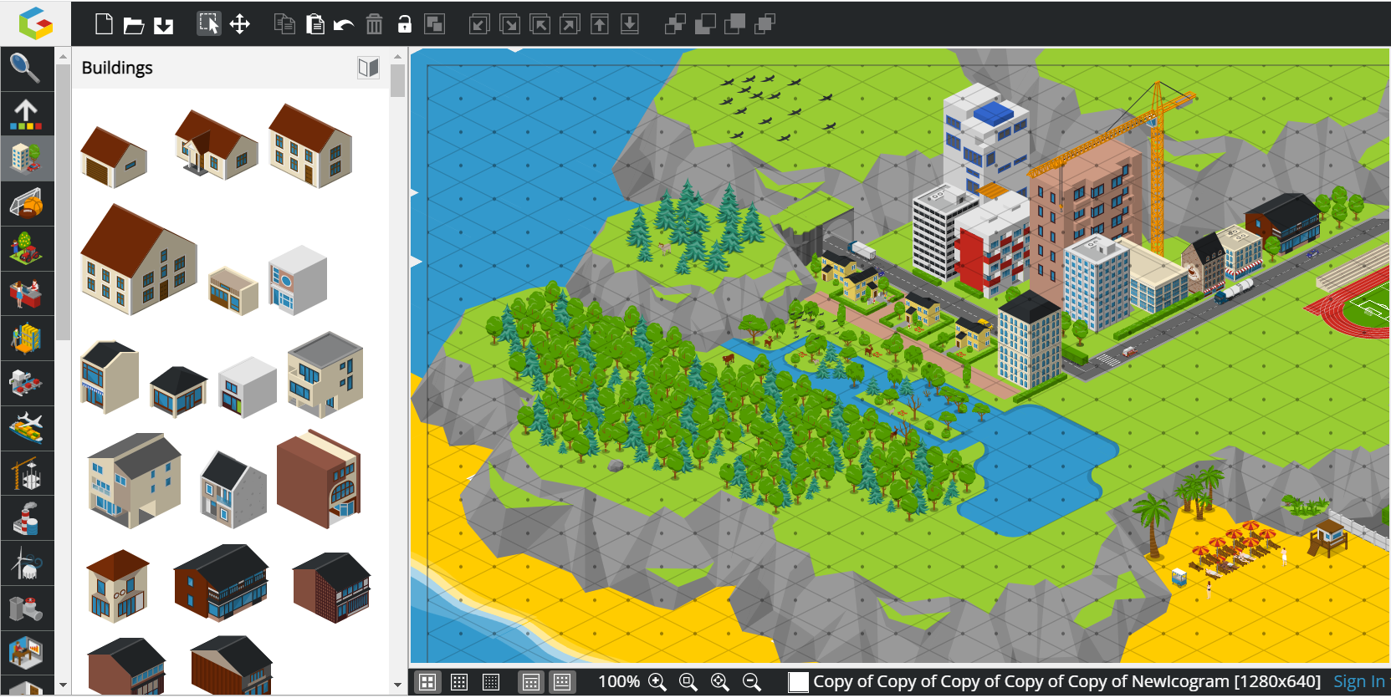
Visuals
Icograms was used to create the background image
Adobe Illustrator was used to edit the visuals in accordance with the requirements of the game story, decision tree and coding.

Slide 17
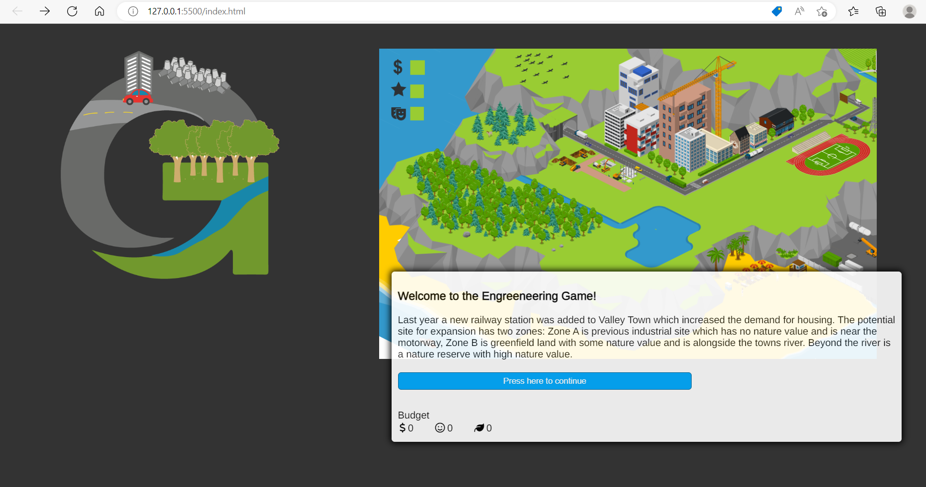
Example Run Through

Slide 18
Future Steps
Implementing in projects!
We would like your input and ideas.
Menti + CASE

